Slide 1
Augmented Vehicular Reality
Hang Qiu, Fawad Ahmed, Marco Gruteser,
Fan Bai, Ramesh Govindan and Gorkem Kar
Presented by: Sidharth Raj

Slide 2
What is self-driving car?
A self-driving car (sometimes called an autonomous car or driverless car) is a vehicle that uses a combination of sensors, cameras, radar and artificial intelligence to travel between destinations without a human operator.

Slide 3
Current self-driving technology
BMW
Mercedes Benz
Volvo
Cadillac
And we have TESLA!

Slide 4
Auto-pilot crash
4 recorded crashes
3 Tesla and 1 Volvo
Latest, March 2018 in CA involving Tesla Model X

Slide 5
Probable cause
Limited visibility due to occlusions, sensing range, and extreme weather and lighting conditions.

Slide 6
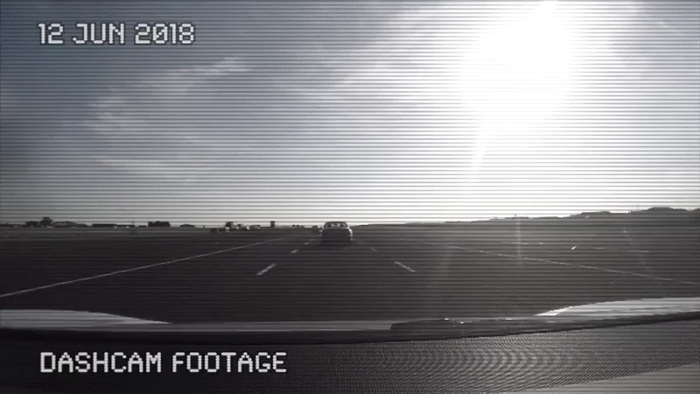
Tesla auto-pilot testing

Slide 7
Abstract
Like today’s autonomous vehicle prototypes, vehicles in the future will have rich sensors to map and identify objects in the environment.
Today’s autonomous vehicle prototypes suffer from a list of limitations.
To improve visibility and performance, not just for autonomous vehicles but for other Advanced Driving Assistance Systems (ADAS), we explore a capability called Augmented Vehicular Reality (AVR).
AVR broadens the vehicle’s visual horizon by enabling it to share visual information with other nearby vehicles, but requires careful techniques to align coordinate frames of reference, and to detect dynamic objects.

Slide 8
Introduction
To improve the system performance, it will be necessary to overcome the limitations of depth sensors.
Besides limited sensing range, they all require line-of-sight visibility.
However, achieving higher reliability will likely require appropriate handling of situations where (a) a vehicle’s sensors cannot detect other traffic participants because line-of-sight availability does not exist, or (b) their range is impaired by extreme weather conditions, lighting conditions, sensor failures, etc..
In this paper, we explore the feasibility of communicating and merging visual information between nearby cars.

Slide 9
Introduction (Cont.)
This would augment vehicular visibility into hazards, and enable autonomous vehicles improve perception under challenging scenarios, or ADAS technologies to guide human users in making proper driving decisions.
This capability, which we call Augmented Vehicular Reality (AVR).
The preliminary design of the AVR explores the use of stereo cameras capable of depth perception.
They generate instantaneous 3-D views of the surroundings in a coordinate frame relative to the camera.

Slide 10
Introduction (Cont.)
This data is then shared with other cars, but AVR must solve the following three problems :
How to resolve the perspective difference between the communicating cars?
How to find a common coordinate frame of reference between two cars?
How to minimize the communication bandwidth and latency for transferring 3-D views?

Slide 11
Background, Motivation and Challenges
Sensing Capabilities in Future Cars:
A crucial component of an autonomous car is a 3-D sensing capability that provides depth perception of a car’s surroundings.
Modern autonomous vehicle rely on a rich variety of accurate perception sensors, including advanced multi-beam LiDar, radar, long-range ultrasonic and forward-facing or surrounding-view camera sensors, to detect and track moving objects while producing a high-definition (HD) map for localization.
This collection of sensors, generates successive point clouds, each of which represents the instantaneous 3-D view of the environment.
A point in the point cloud represents a voxel in the 3-D space, and is associated with a position in 3-D .

Slide 12
Background, Motivation and Challenges (Cont.)
The Problem:
Most of these sensors only provide line-of-sight perception (e.g., LiDar, Radar, (stereo) camera and Infrared sensors) and obstacles can often block a vehicle’s sensing range.
Weather often reduce the sensing range of the system.
In this paper, we explore the feasibility of a simple idea: extending the visual range of vehicles through communication.
Consider two cars, a leader and a follower. The leader can share objects (e.g. stop signs, crosswalks, potholes, pedestrians) in it’s range, unknown to the follower.
The follower then uses this information to make safe driving decisions.
An AVR capability across vehicles can potentially provide more accurate information (today’s navigation apps rely on crowdsourcing, and their accuracy is spotty), together with precise positions of these hazards.

Slide 13
Background, Motivation and Challenges (Cont.)
Challenges:
For AVR, each vehicle needs to transform the view received from the other vehicles into its own view. To be able to do this very accurately, ‘perspective transformation’ needs both the exact position of the sensor and the orientation at a high resolution.
The high volume of data generated by the sensors can easily overwhelm the capabilities of most existing or future wireless communication systems.
AVR needs to have an extremely low end to end latency in order to achieve real-time extended vision. Thus, it requires fast object extraction, low communication latency, and fast perspective transformation and merging processing.

Slide 14
AVR Design
AVR creates an extended 3-D map, updated in real-time, of a vehicle’s surroundings regardless of any line-of-sight occlusions.
AVR leverages a crowd-sourced sparse HD map to enable vehicles to position themselves relative to each other, by positioning themselves relative to the same static objects in the environment.
It utilizes wireless communication to share vehicle views. To minimize the communication overhead, AVR shares only moving objects.

Slide 15

AVR Design (Cont.)

Slide 16
AVR Working
Each vehicle continuously captures point clouds and, using a pre-computed sparse HD map containing features of static objects in the environment, localizes itself in a coordinate frame relative to the camera that captured the sparse HD map.
Meanwhile, each vehicle also isolates point cloud of dynamic objects in the environment, and transmits these to vehicles nearby, either using V2V technologies or using road-side or cloud infrastructure.
Other vehicles can also position themselves in the same relative coordinate frame of reference, so, when they receive point clouds from other vehicles, they can merge these into their own camera’s reference frame.
Before doing so, they must do a perspective transformation that accounts for perspective differences between the two vehicles.

Slide 17
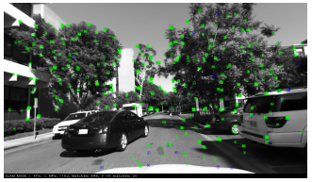
AVR Working (Cont.)
AVR also incorporates a state-of-the-art object recognition framework trained on a vehicular scenario, the framework detects interesting objects, i.e., cars, pedestrians, etc., and localizes and draws a 2-D bounding box on the frame.
Feature detection and 3-D matching

Slide 18
Localization using Sparse 3-D Feature Maps
To solve the problem of localizing one vehicle with respect to another, AVR leverages prior work in stereo-vision based Simultaneous Localization And Mapping (SLAM).
This work generates sparse 3-D features of the environment, where each feature is associated with a precise position.
In AVR, as a car traverses a street, all stable features on the street, from the buildings, the traffic signs, the sidewalks, etc., are recorded, together with their coordinates, as if the camera were doing a 3-D scan of the street.
Each car can then crowd-source its collected map.
The mechanisms for this crowd-sourcing is left for future works.

Slide 19
Localization using Sparse 3-D Feature Maps (Cont.)
AVR needs only one traversal to collect features sufficient for a map since these features represent static objects in the environment.
The amount of data needed for each road segment depends on the complexity of the environment.
As an example, AVR creates 97MB of features for a 0.1 mile stretch of a road.

Slide 20
Extending Vehicular Vision
With the help of a common coordinate frame, vehicles are able to precisely localize themselves.
However, if car A wants to share its point cloud with car B, AVR needs to transform the objects or point cloud in A’s local view to B’s.
AVR performs Perspective Transformations between the local and global coordinate frames.

Slide 21
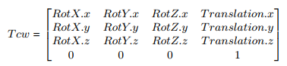
Perspective Transformation
Consider two views from two different vehicles.
AVR introduces the common coordinate frame to bridge the gap between the two perspectives.
The camera pose in the common frame is represented by a transformation matrix, which is a 3x3 rotation matrix and a 3 element translation vector.

Slide 22
Perspective Transformation (Cont.)
The translation is equivalent to the camera coordinate in the common frame, and the rotation matrix indicates the rotation of the camera coordinate frame against the common coordinate frame.

Slide 23
Detecting and Isolating Dynamic Objects
To reduce the transmission load we need to find a way to isolate dynamic objects only.
This can be achieved by analyzing the motion of each voxel in successive frames.
Unfortunately, it is a non-trivial task to match two voxels among consecutive frames. Prior point cloud matching techniques involve heavy computation unsuitable for real-time applications.
AVR extracts SURF features for matching and finds the position of the current frame in the last frame.
Then, thresholding the Euclidean distance between matching voxels from consecutive frames can isolate the dynamic points from the static ones

Slide 24
Detecting and Isolating Dynamic Objects (Cont.)
In the initial experiments, AVR successfully filtered out all stationary objects, and extracted only the moving objects in the scene.
One experimental optimization includes exploiting object detector to narrow the space for moving objects. Once we identify the pixels related to moving objects, we can reduce the search space for moving objects.

Slide 25
Preliminary Evaluation
The setup included setting up two cars with stereo cameras ZED with smartphone attached to it.
The stereo camera records the video stream and computes the 3D point cloud.
The mobile phone records GPS and all motion sensors, i.e., gyroscope, accelerometer, magnetometer, etc..
ZED can create the real-time point cloud at a framerate of 30fps on a Titan X GPU with a resolution of 720P (1280 x 720), and up to 100 fps with VGA (640 x 480).
For object recognition, AVR uses YOLO, a state-of-the-art object detector.

Slide 26
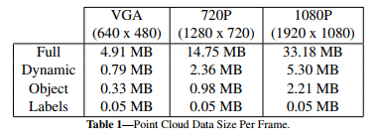
Preliminary Evaluation (Cont.)
Bandwidth and Latency
The table summarizes the bandwidth requirement of transferring different representations of vehicle surroundings with various granularities.

Slide 27
Preliminary Evaluation (Cont.)
AVR can share these representations either via direct V2V communication, or indirectly through the road side units or the cloud.
However, existing state-of-the-art wireless communication technologies cannot support any representation except coarse labels.
In practice, a peer-to-peer (P2P) Wi-Fi direct link and a server for LTE transmission was created over cloud, to measure the performance of point cloud transfer.

Slide 28
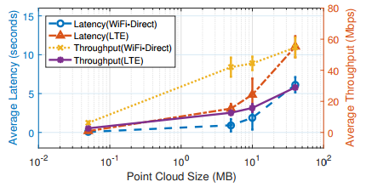
Preliminary Evaluation (Cont.)
As expected, the throughput increases as the file size increases because it allows the TCP congestion window to open up fully and utilize more bandwidth.
We observed that when we reduced the point cloud size in log scale, the latency drops only linearly.
The latency of V2V communication is still inadequate, and there are plans to explore this dimension in the future.

Slide 29
Challenges and Future works
Try to leverage other techniques adopted in latency sensitive applications like gaming and interactive VR, such as dead reckoning or motion prediction.
Leveraging the trajectory of the vehicle, information from maps, and the constraints on pedestrians, we might be able to correctly predict motion over short time scales.
There are plans to explore advanced voxel compression techniques to address the bandwidth bottleneck.
Future work will need to address security and privacy concerns that may arise from communicating visual information between vehicles. AVR will also focus on improving the throughput of processing objects, addressing the bandwidth constraints, and reducing latency.

Slide 30
Conclusion
We discussed a new capability, Augmented Vehicular Reality, and sketched the design and implementation of an AVR system.
AVR is not only beneficial to human drivers as a driving assistant system, but also, more importantly, enables extended vision for autonomous driving cars to make better and safer decisions.

Slide 31
Thank You!
Any Questions?
Bring it on!
(Courtesy: Abhinav Dutta)

